Slide 1
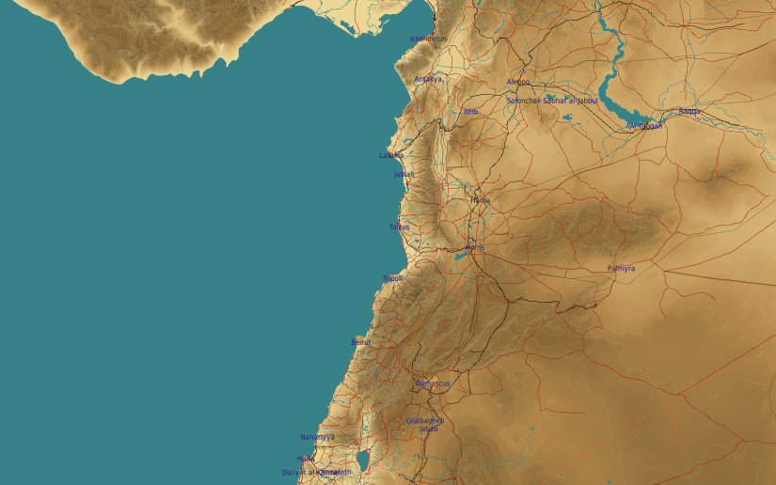
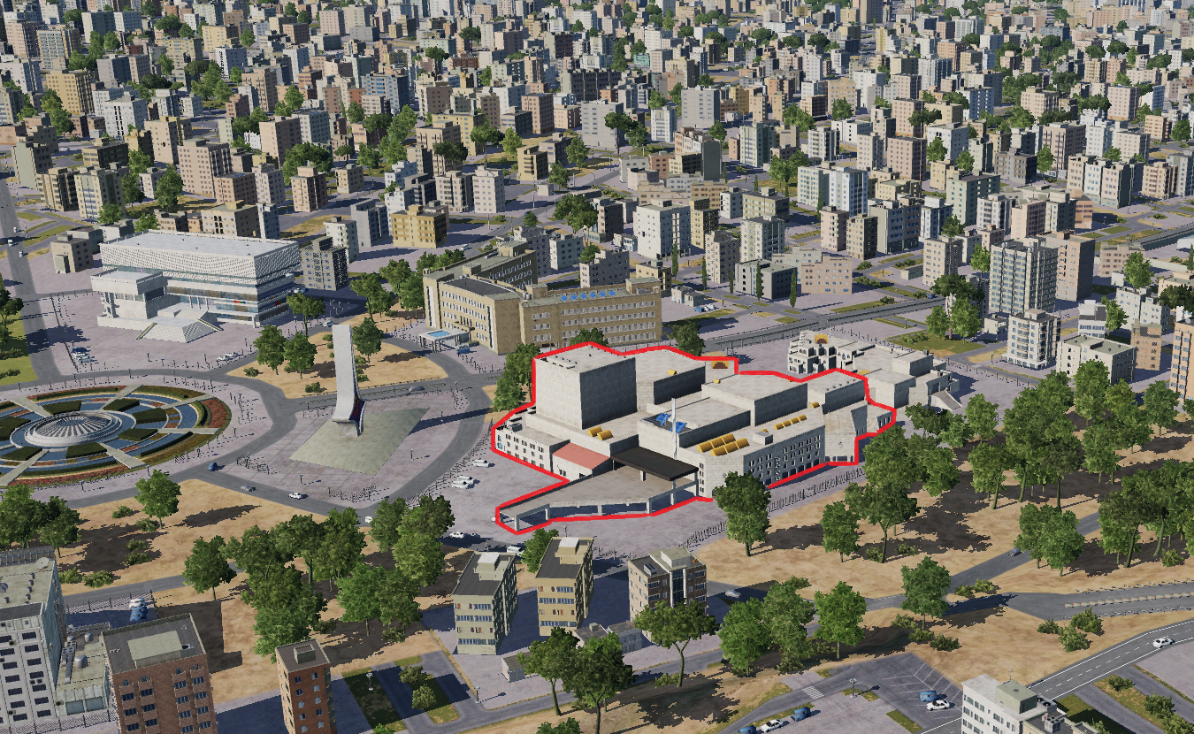
SYTGT035 International communication center
N
DPI 1-2
Syrian Armed Forces Propaganda
35
DESCRIPTION OF THE DESIRED POINTS OF IMPACT WITH WPN TYPE:
SYTGT035A – Propaganda
DPI 1 N33 30.755 E036 16.690/2260ft/(500 Ibs bombs)
DPI 2 N33 30.747 E036 16.703/2260ft/(500 lbs bombs)
SYTGT035B – Servers
DPI 3 N33 30.735 E036 16.723/2260ft/(2000 lbs bomb)
Suggested fuzing solution on DPI 3 –Delayed fusing required in order to effect the servers located in the basement.
DPI 3. Syrian Armed Forces Backup Servers.
4
5
6
Collateral damage concerns surround the centre.
7
8

